Slide 1


E-SmartLib RHSTI
An Enchanced Library Borrowing and Returning System Using QR Codes and Scanner, with Time-in/Time-out Attendance
Software Engineering 2 · Final Defense · November 24, 2026
[Scan Go Group] · [Group Leader: Asis Karen Claire N. , Member: Rada Ahron Melvin, Sulit John Lloyd, Lozano King Jasper, Laguador Jake, Era Ken James, Sarte Tim Jaztin, Bacos Francis, Turla Alexander, Jalimao John Vincent, Agripa John Carlo, Entong Eduard John, Lacheca Charles Kenneth] · Mabini Colleges, Inc. – BSCS
Notes:
Greet the panel. State the project title, group name, and who will present.

Slide 2
01 · PROJECT
Project Overview
Existing system
Intended users
Problem
Advance Library System of The Ripple of Hope Skills and Technology Institute (RHSTI)
Students, librarians, and administrators of the school library
Manual encoding, no QR workflow, no student portal, no attendance tracking
Enhancement
Relevance
E-SmartLib: QR-based automation, cloud hosting, and an installable web app
Education: faster and better organized library service for students
E-SmartLib RHSTI · SE2 Final Defense · 2
Notes:
Explain who owns the existing system and why the enhancement is needed. [Add the owner or contact name and how long the existing system has been in use (6 months or more).]

Slide 3
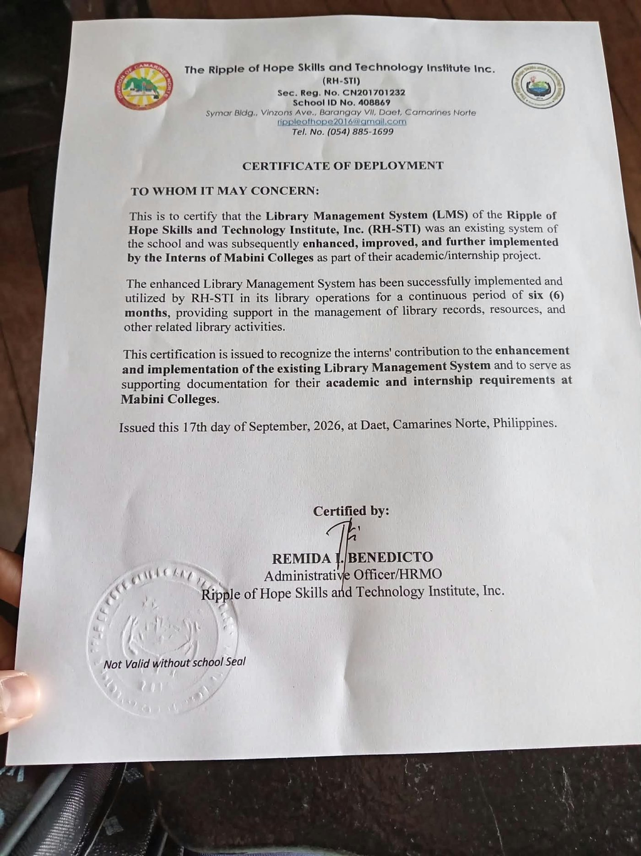
02 · EXISTING SYSTEM
Existing System Analysis
Aspect | Advance Library System
Technology | PHP, MySQL (db_ls), Bootstrap, DataTables, XAMPP
Functions | Admin, student, and teacher records; book records; borrow and return; Excel/CSV import
Database | admin, book, borrowing, student, students
Limitations | Manual encoding; no QR scanning, attendance, student portal, or password recovery
Certificate of Deployment issued September 17, 2026 by RH-STI (Remida I. Benedicto, Administrative Officer/HRMO). It certifies the Library Management System was used in library operations for a continuous period of six (6) months.
E-SmartLib RHSTI · SE2 Final Defense · 3
Notes:
Describe the old system and its limitations. Show the Certificate of Deployment (issued September 17, 2026) as evidence of operational status. Be ready to explain that it certifies six months of continuous use.

Slide 4
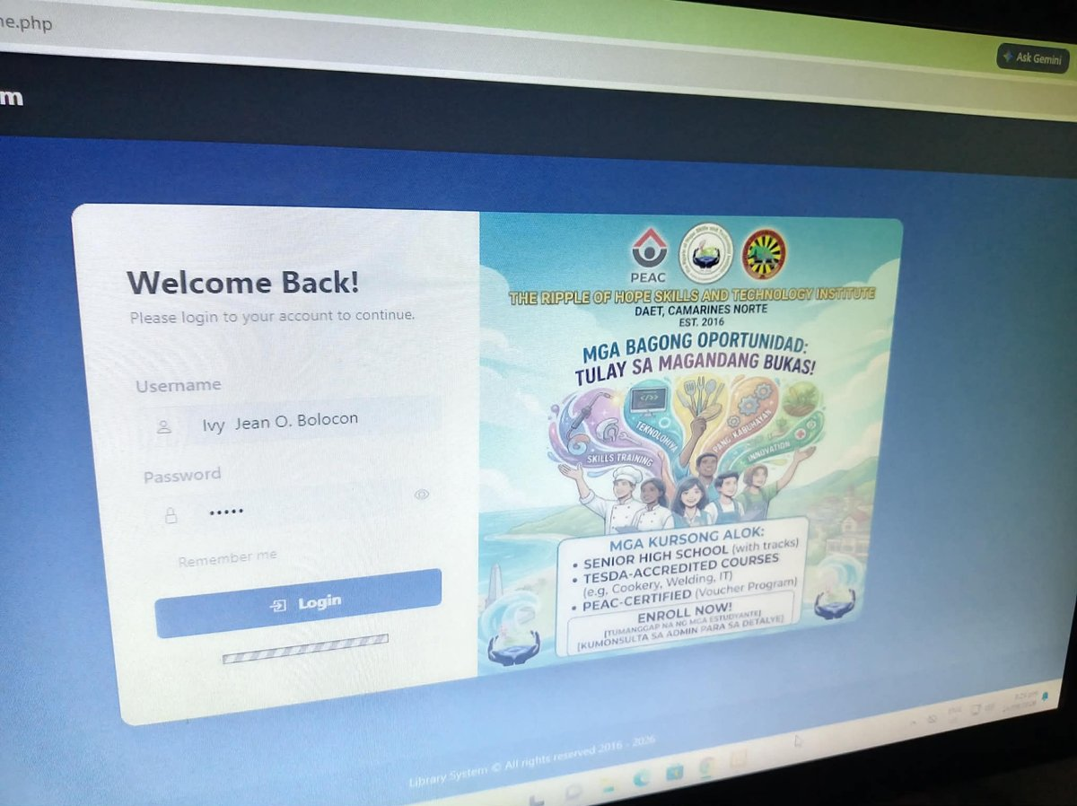
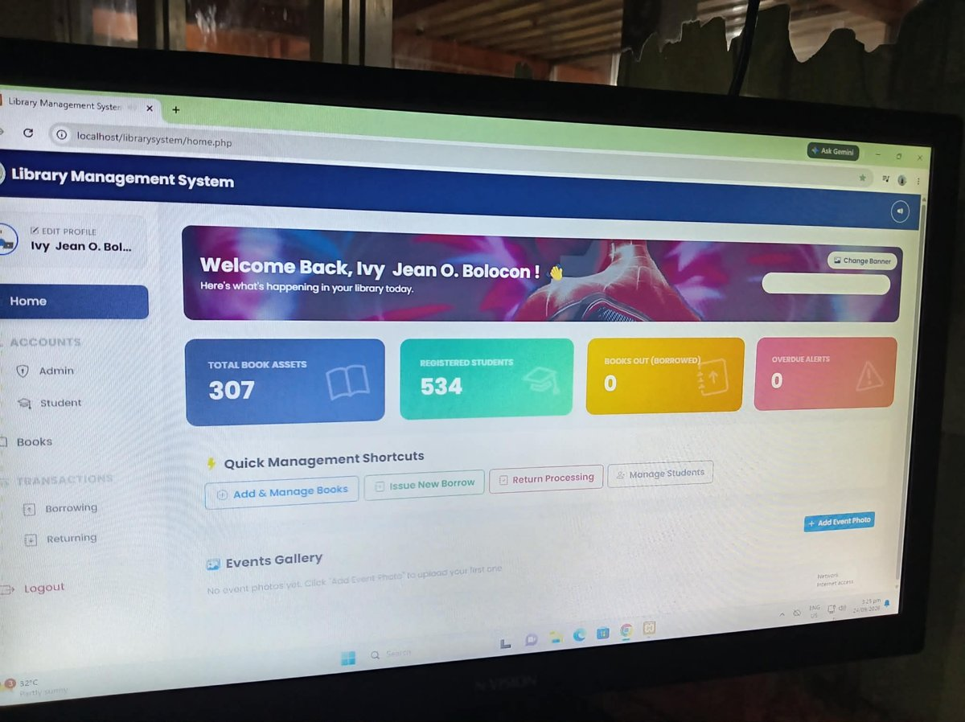
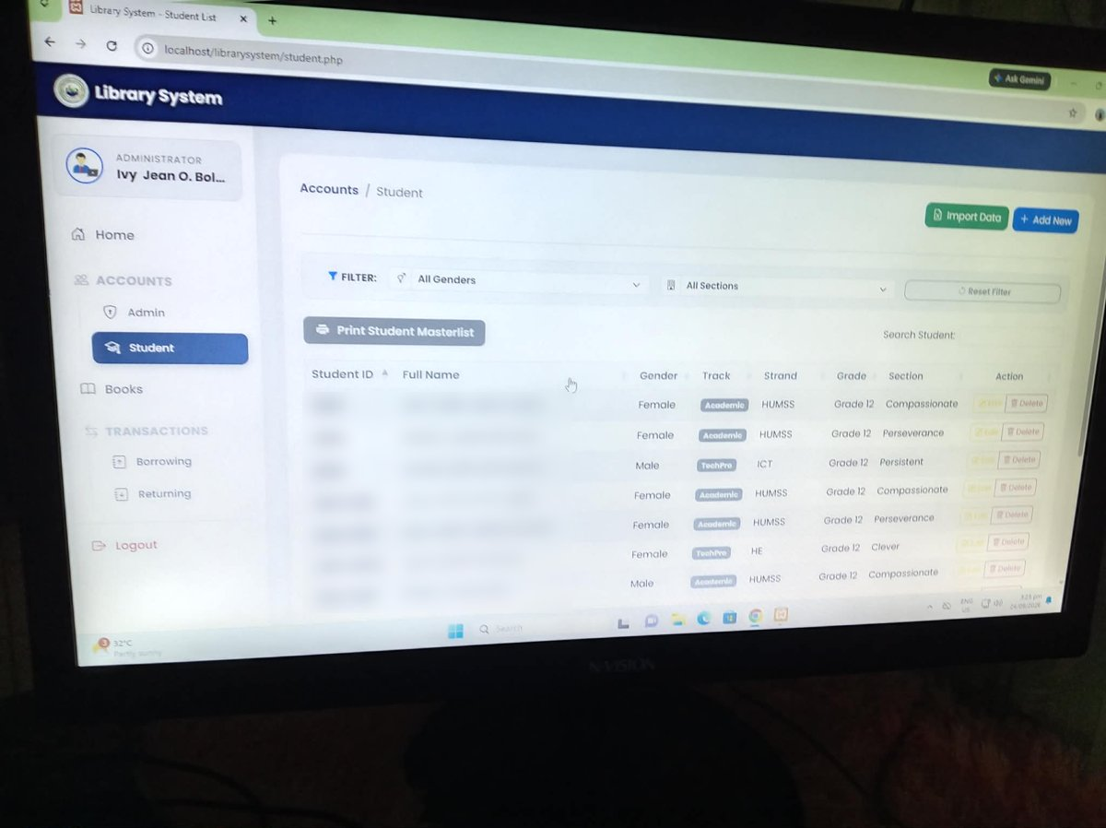
02 · EXISTING SYSTEM
Existing System: Login, Dashboard, Students
Login page
Admin dashboard
Student list
Username and password login for the library administrator.
Totals for books, registered students, books borrowed, and overdue alerts, with shortcuts.
Filter by gender and section, import data, and print the student masterlist.
E-SmartLib RHSTI · SE2 Final Defense · 4
Notes:
Screenshots of the actual existing Advance Library System (localhost/librarysystem), taken September 24, 2026. Student names are blurred for privacy.

Slide 5
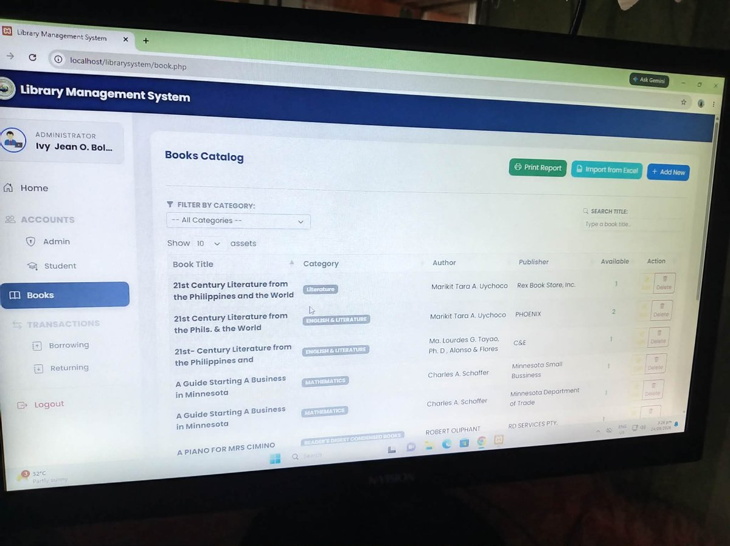
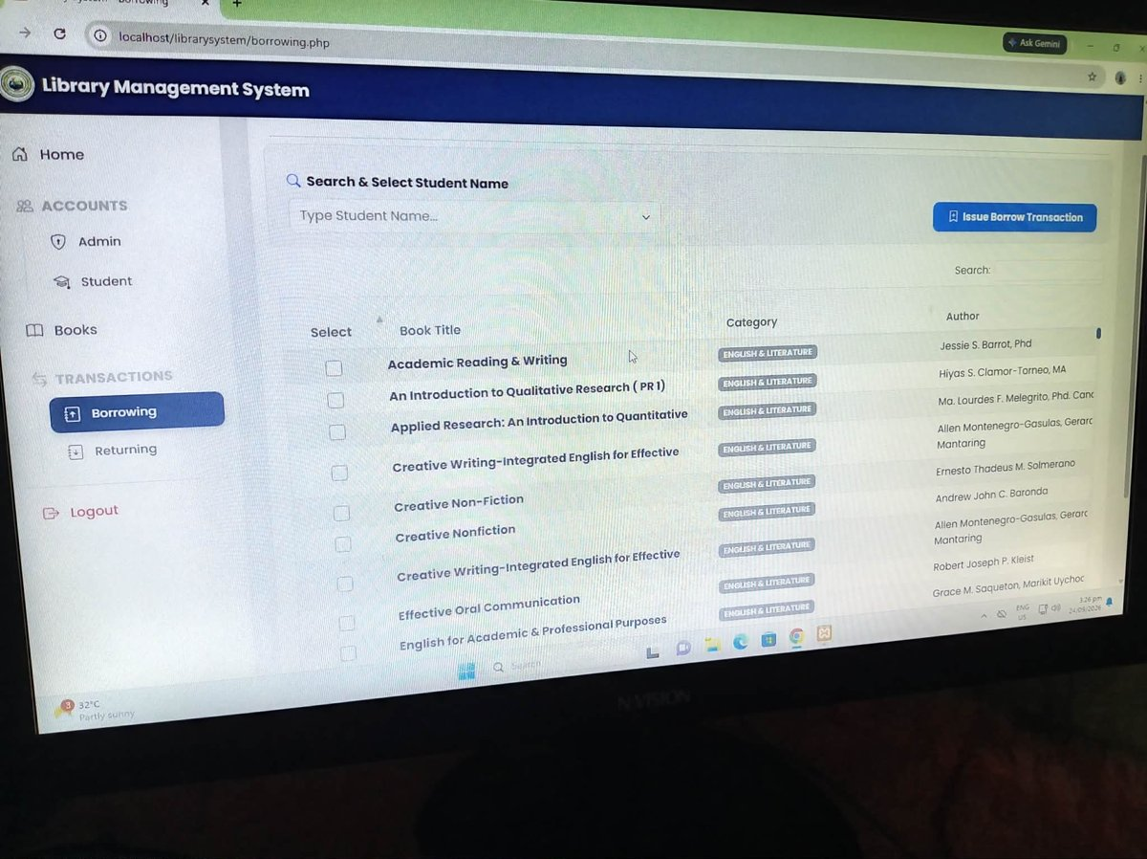
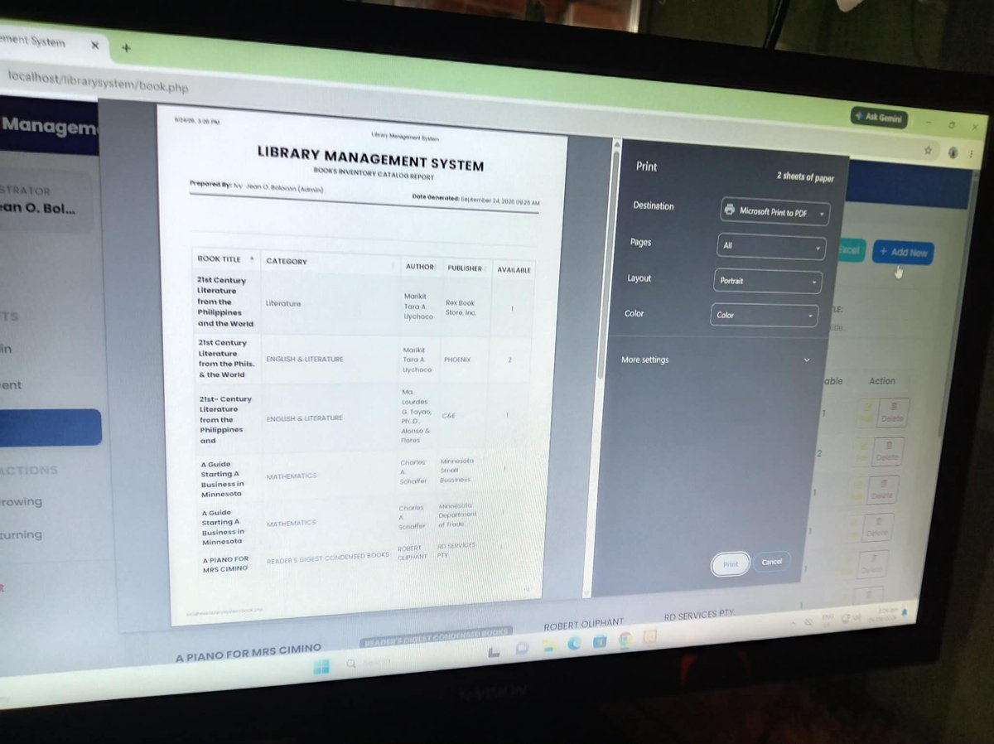
02 · EXISTING SYSTEM
Existing System: Books and Transactions
Books catalog
Borrowing
Printed report
Catalog with category filter, search, Excel/CSV import, and print report.
Select a student by name, tick the books, and issue a borrow transaction manually.
Books inventory catalog report generated by the system.
E-SmartLib RHSTI · SE2 Final Defense · 5
Notes:
Point out that every transaction is encoded by hand. There is no QR scanning, which is what the enhancement adds.

Slide 6
03 · SCOPE
Objectives, Scope, and Modules
Objectives
Scope
Limitations
[Insert the approved general and specific objectives]
RHSTI library circulation: students, books, borrow and return, attendance, student dashboard
7-day loan period, up to 3 books per student, [add others]
Admin / Librarian | Student
Dashboard, Students, Books, Borrow, Return, Time-In/Out, History | Student dashboard, book requests, change password, chat
Account and settings, password reset codes, book requests | Installable app (PWA)
E-SmartLib RHSTI · SE2 Final Defense · 6
Notes:
Read the approved objectives exactly as approved. The modules come from the actual code.

Slide 7
04 · TECHNOLOGY
Technological Enhancement
QR automation
Cloud hosting
Student QR: STU:<student_no>, book QR: BK:<accession_no>. USB scanner or camera scanning for borrow, return, and time-in/out
Live on web hosting (esmartlib.com), with a separate hosting-config file for credentials
Installable web app
Analytics dashboard
Manifest and service worker so the app can be installed on a phone
Last 7 days chart and overdue books list using Chart.js
E-SmartLib RHSTI · SE2 Final Defense · 7
Notes:
Explain how a QR code travels from scan to database record. Do not claim offline support unless it is actually working.

Slide 8
05 · ARCHITECTURE
System Architecture
Users
QR scanner
PHP backend
MySQL
Admin, librarian, student (browser or PWA)
USB scanner or Html5Qrcode (camera)
api.php, config.php, PDO
14 tables
Main tables: students, books, borrowings, attendance, book_requests, chat_conversations, chat_messages, users, password_reset_codes, login_attempts, settings.
E-SmartLib RHSTI · SE2 Final Defense · 8
Notes:
Follow the data flow: scan, api.php, database, response on screen. Be ready to explain what each file does.

Slide 9
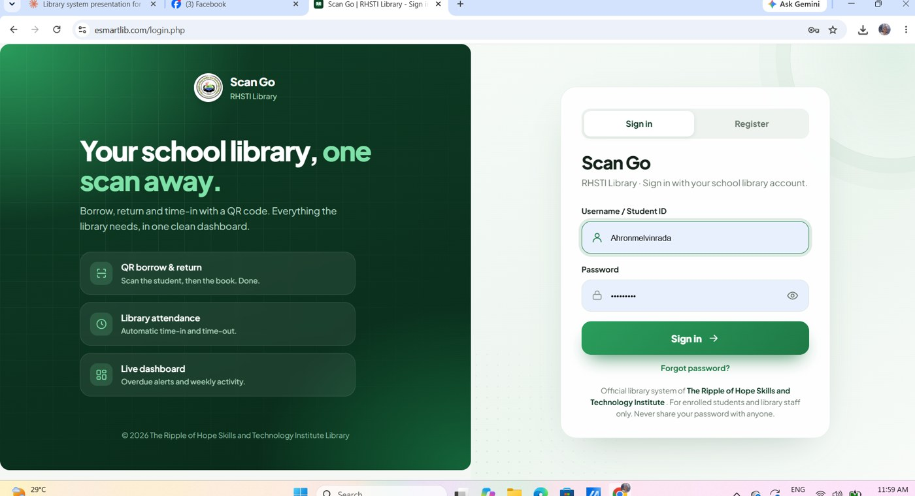
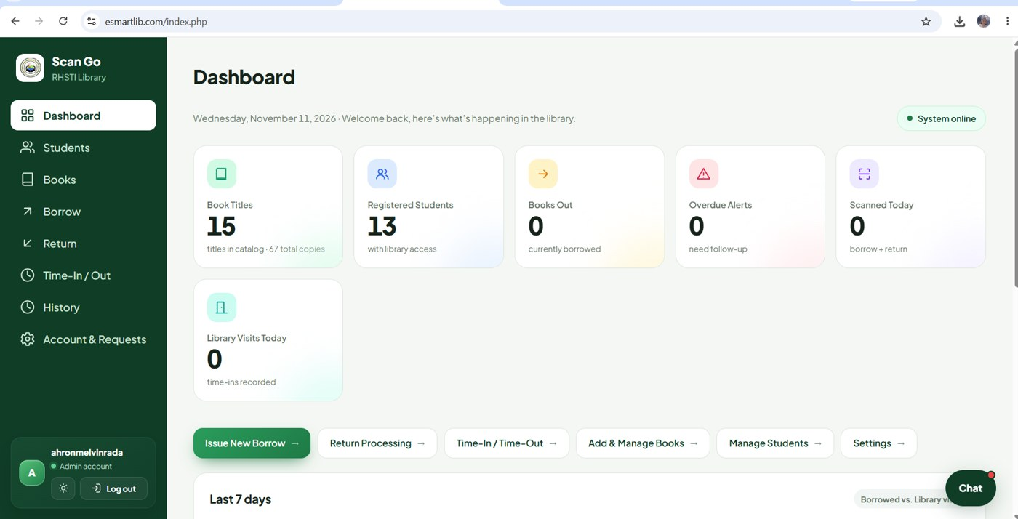
06 · LIVE DEMO · STEP 1 OF 9
Enhanced System: Login and Dashboard
Login page (Scan Go)
Admin dashboard
Sign in with username or Student ID. Highlights QR borrow and return, attendance, and a live dashboard.
Book titles, registered students, books out, overdue alerts, scans today, and library visits today.
E-SmartLib RHSTI · SE2 Final Defense · 9
Notes:
Live system at esmartlib.com, screenshots taken November 11, 2026. Be ready to demonstrate each screen live.

Slide 10
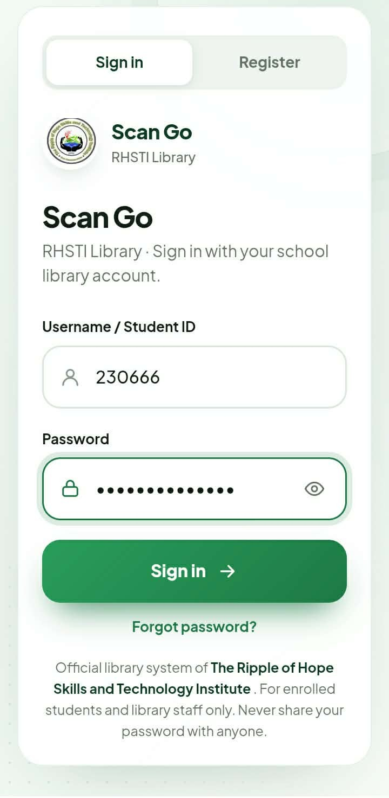
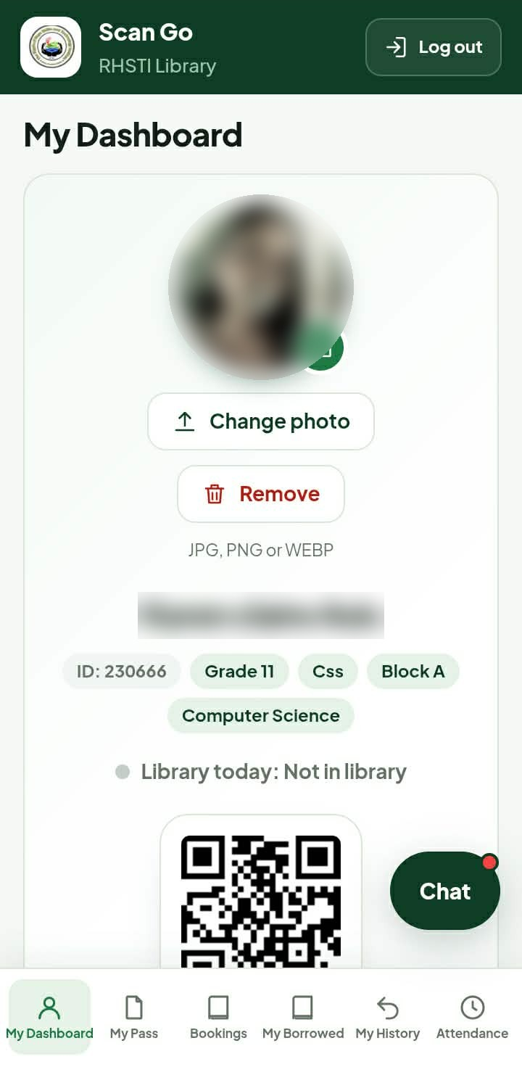
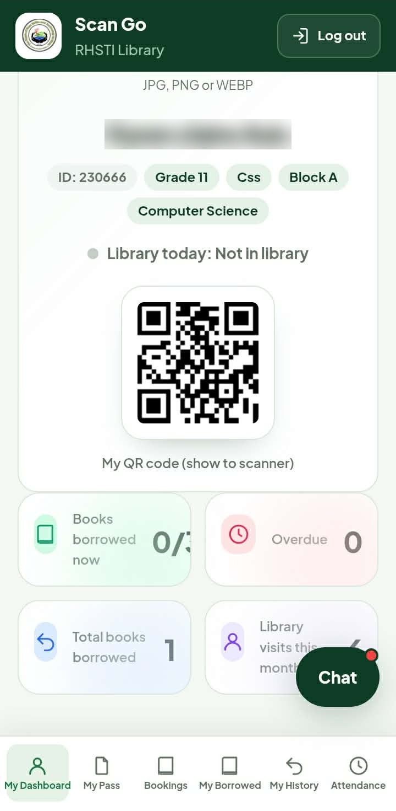
06 · LIVE DEMO · STEP 2 OF 9
Student Portal: Sign-in and Dashboard
Sign in
Log in with a username or Student ID. New students can register.
Student dashboard
Profile photo, grade, section, and today’s library status.
QR code and summary
QR code for the scanner, books borrowed (limit 3), overdue, and visits.
Student photo, name, and email are blurred for privacy.
E-SmartLib RHSTI · SE2 Final Defense · 10

Slide 11
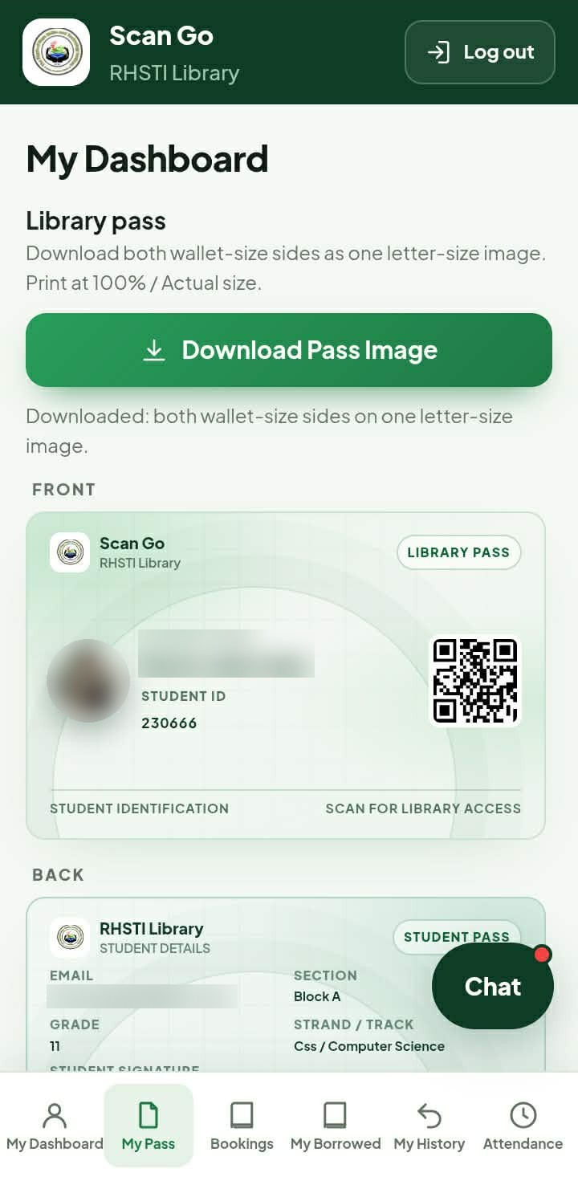
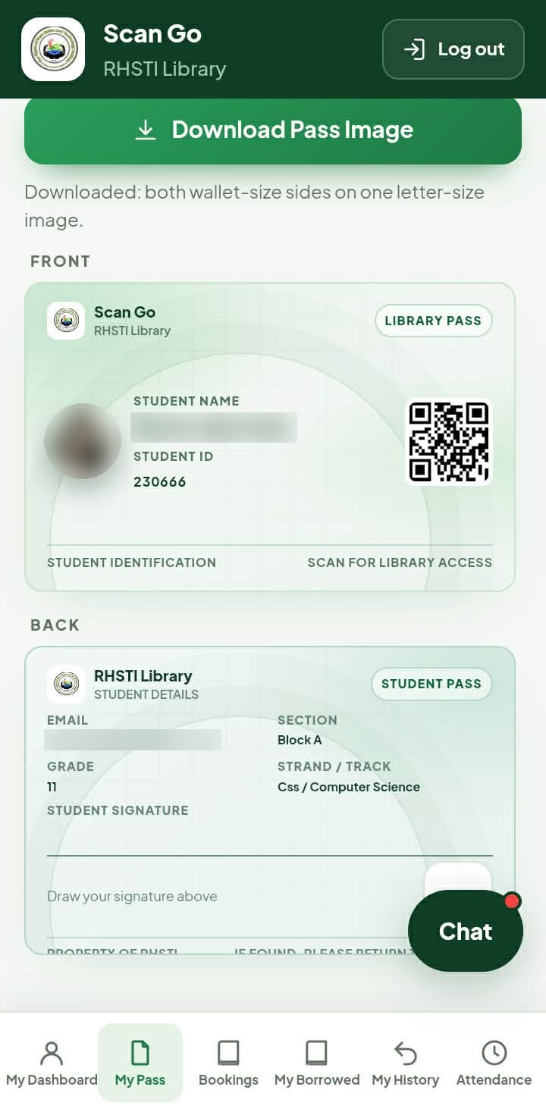
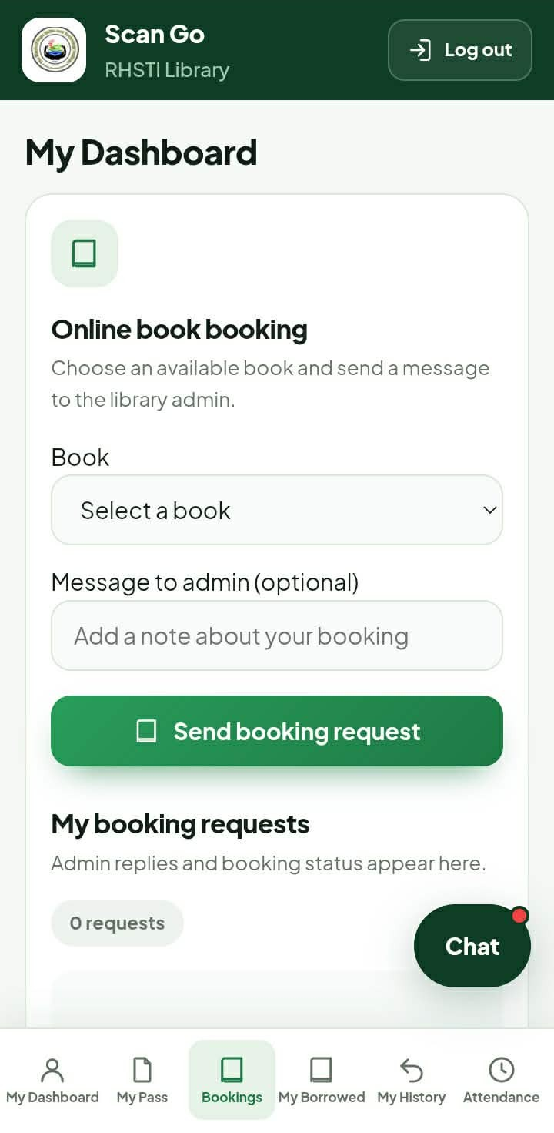
06 · LIVE DEMO · STEP 3 OF 9
Student Portal: Library Pass and Booking
Library pass (front)
Wallet-size pass with photo, student ID, and QR code.
Library pass (back)
Student details and signature area. Download and print at actual size.
Online booking
Pick an available book and send a request to the admin.
Student photo, name, and email are blurred for privacy.
E-SmartLib RHSTI · SE2 Final Defense · 11

Slide 12
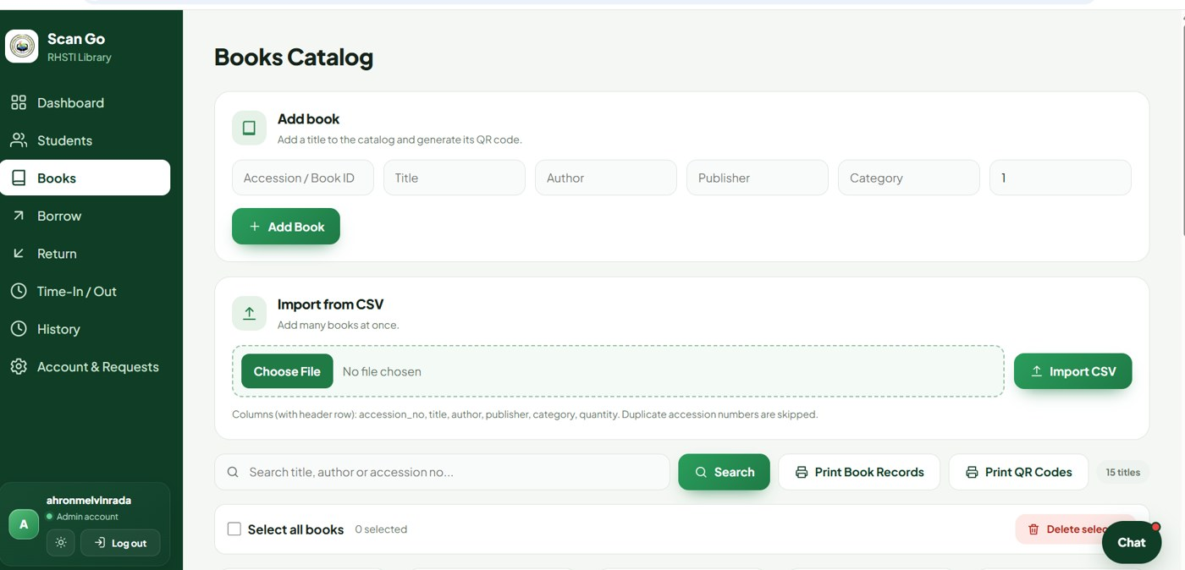
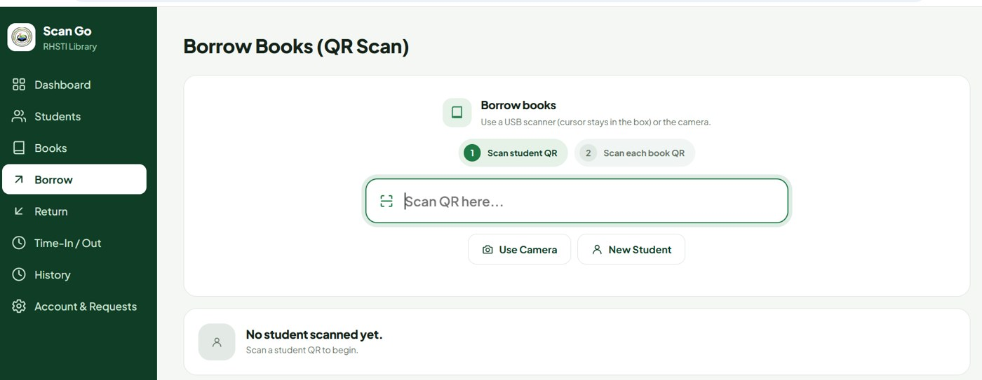
06 · LIVE DEMO · STEP 4 OF 9
Enhanced System: Books Catalog and QR Borrowing
Books catalog
Borrow books (QR scan)
Add a book and generate its QR code, import from CSV, and print book records or QR codes.
Step 1: scan the student QR. Step 2: scan each book QR, using a USB scanner or the camera.
E-SmartLib RHSTI · SE2 Final Defense · 12
Notes:
This is the main enhancement over the manual encoding of the old system.

Slide 13
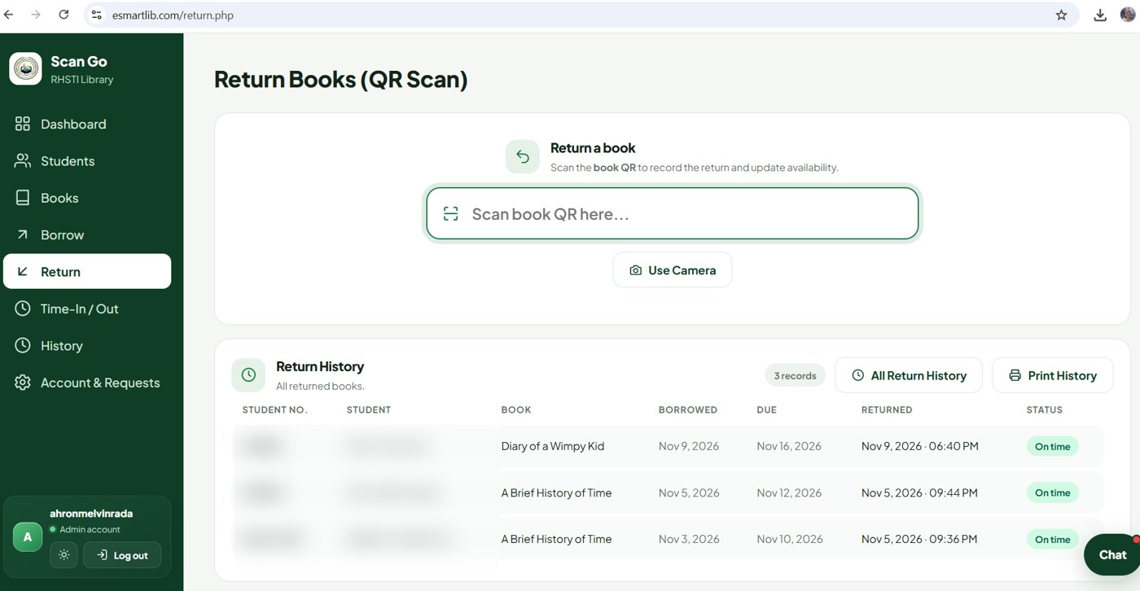
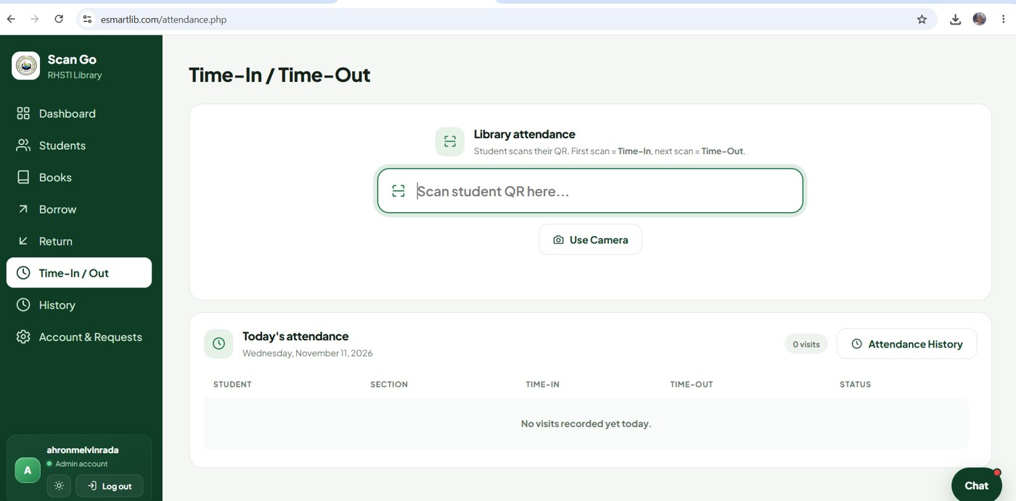
06 · LIVE DEMO · STEP 5 OF 9
Enhanced System: Return and Attendance
Return books (QR scan)
Time-in / time-out
Scan the book QR to record the return and update availability. Student names are blurred.
First scan is time-in, next scan is time-out. Today's attendance is listed.
E-SmartLib RHSTI · SE2 Final Defense · 13
Notes:
Show a return and a time-in scan live.

Slide 14
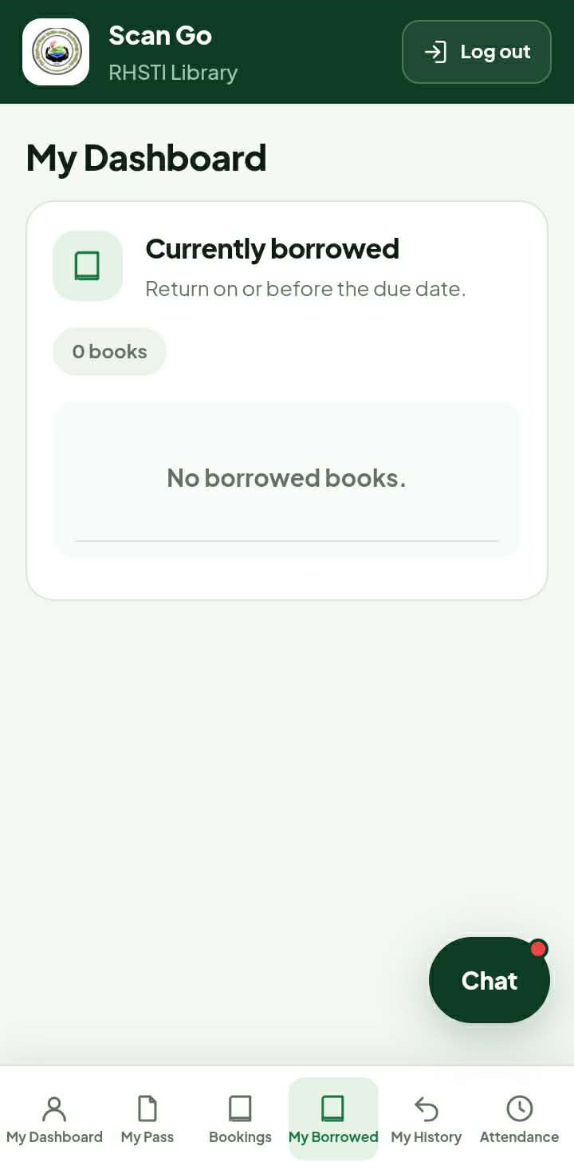
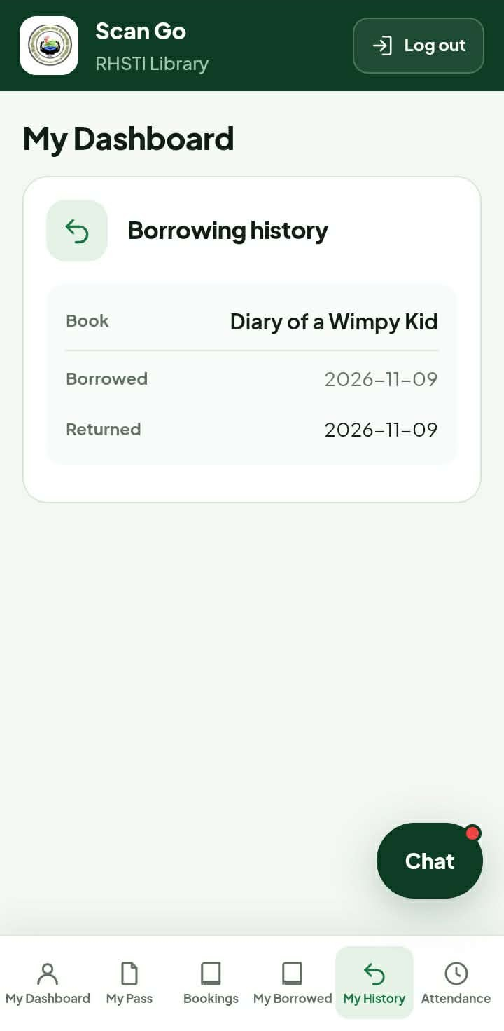
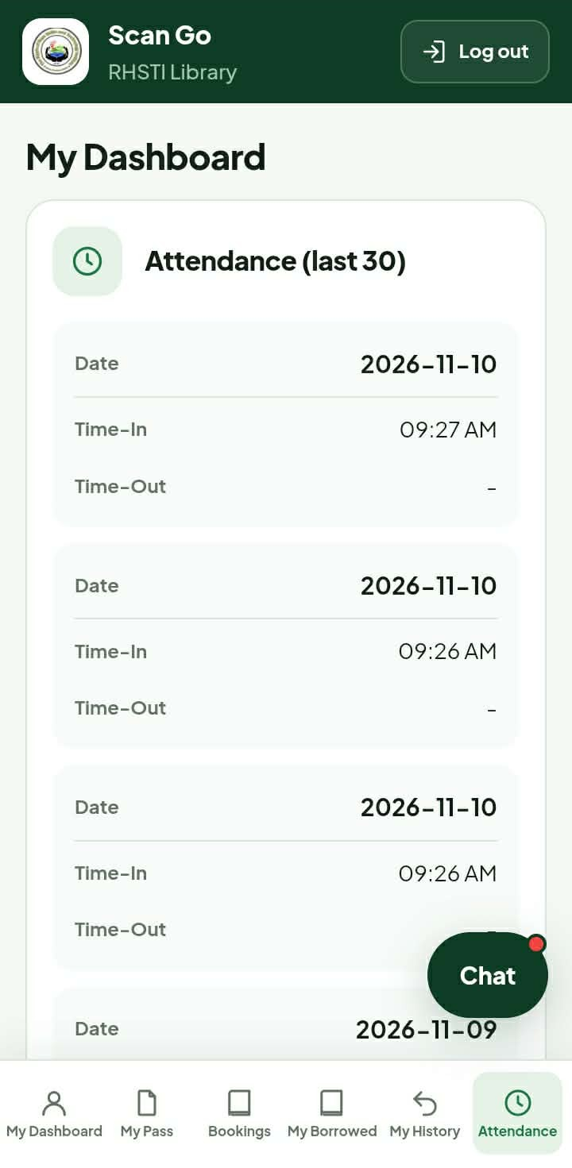
06 · LIVE DEMO · STEP 6 OF 9
Student Portal: Borrowed, History, Attendance
Currently borrowed
Books on loan and due dates. None at the moment.
Borrowing history
Past books with borrowed and returned dates.
Attendance
Time-in and time-out log for the last 30 visits.
E-SmartLib RHSTI · SE2 Final Defense · 14

Slide 15
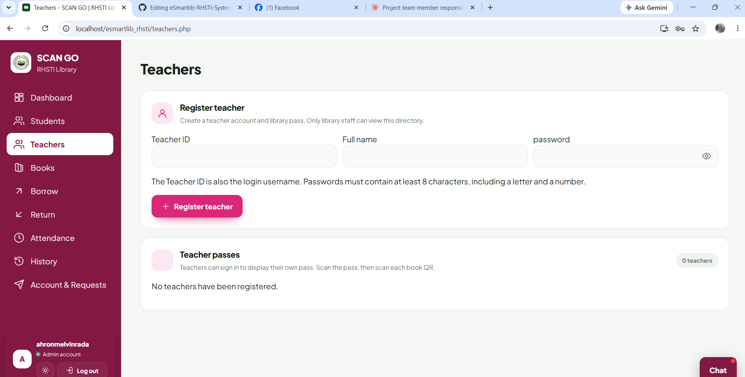
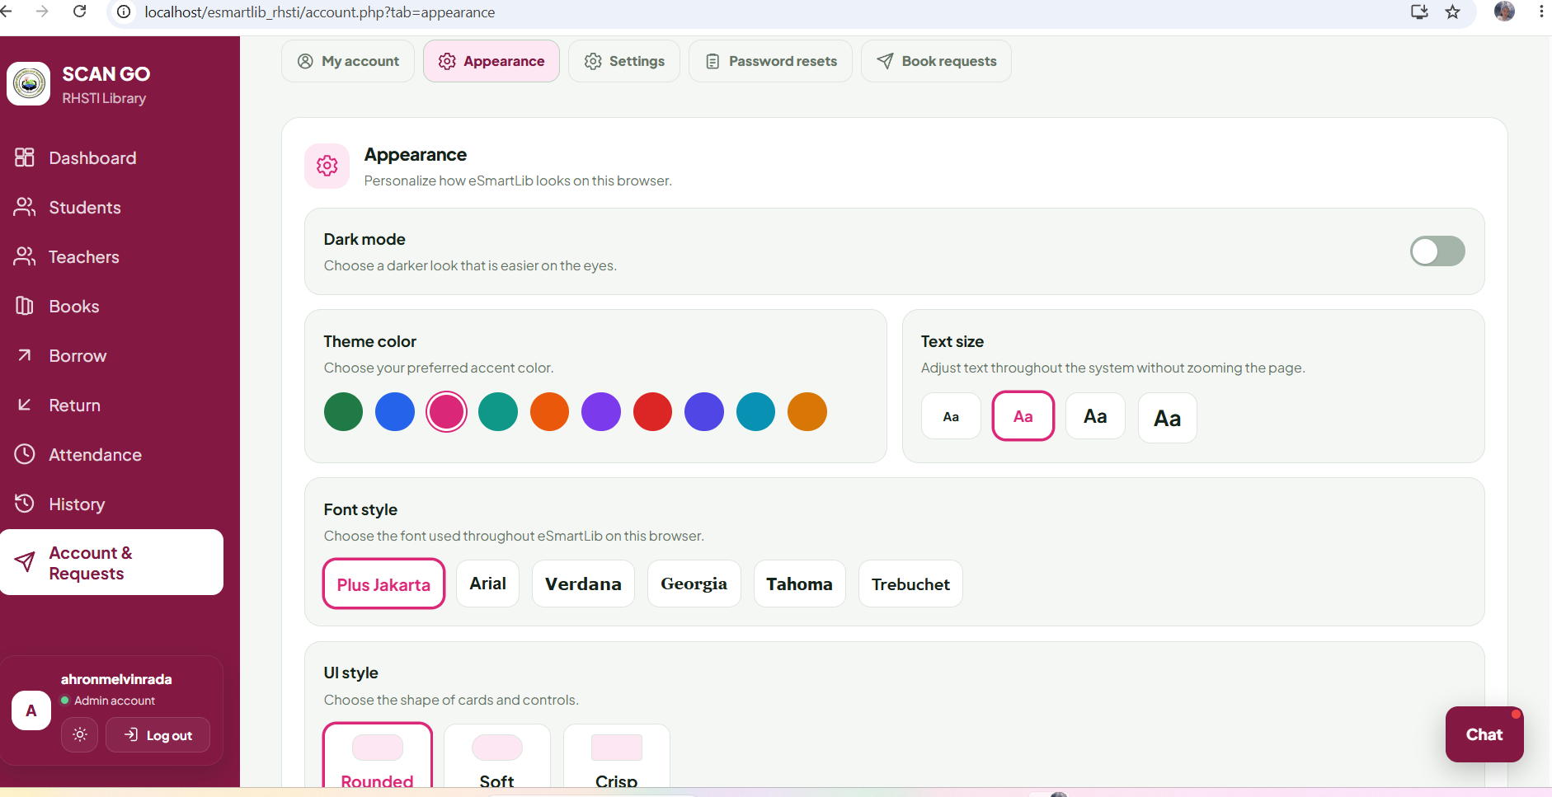
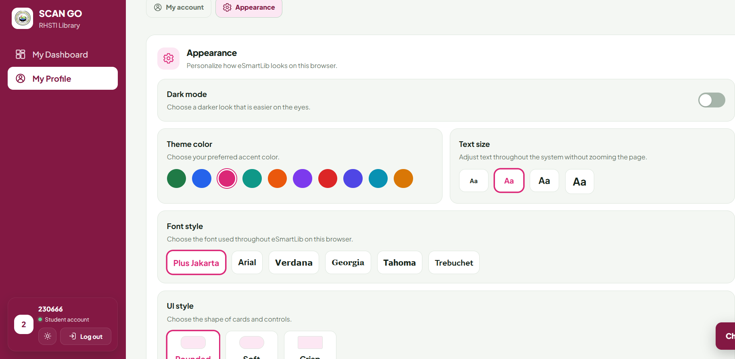
06 · LIVE DEMO · STEP 7 OF 9
Enhanced System: Teachers and Appearance
Teachers
Register teacher accounts with a Teacher ID, full name, and password. Teachers sign in to show their own library pass for scanning.
Appearance (admin)
Dark mode, theme color, text size, font style, and UI style, saved per browser.
Appearance (student)
The same appearance options are available in the student portal under My Profile.
E-SmartLib RHSTI · SE2 Final Defense · 15

Slide 16
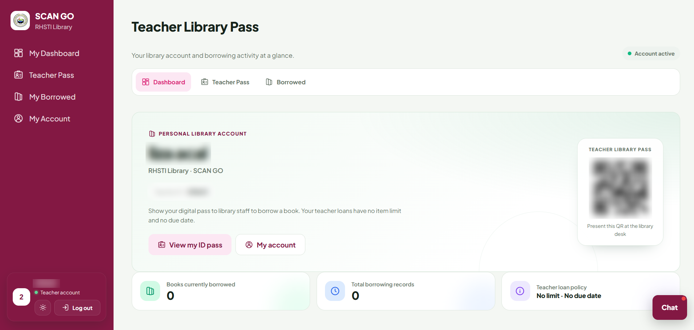
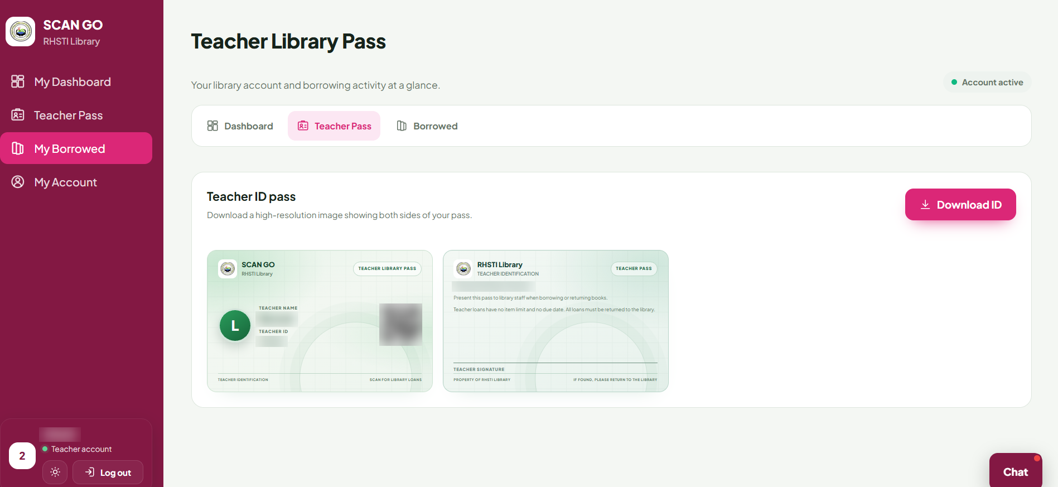
06 · LIVE DEMO · STEP 8 OF 9
Teacher Portal: Dashboard and Library Pass
Teacher dashboard
Teacher library pass
Teacher ID, QR pass, books currently borrowed, and loan policy: no item limit and no due date.
ID-style pass with QR code, front and back, downloadable as one high-resolution image.
E-SmartLib RHSTI · SE2 Final Defense · 16

Slide 17
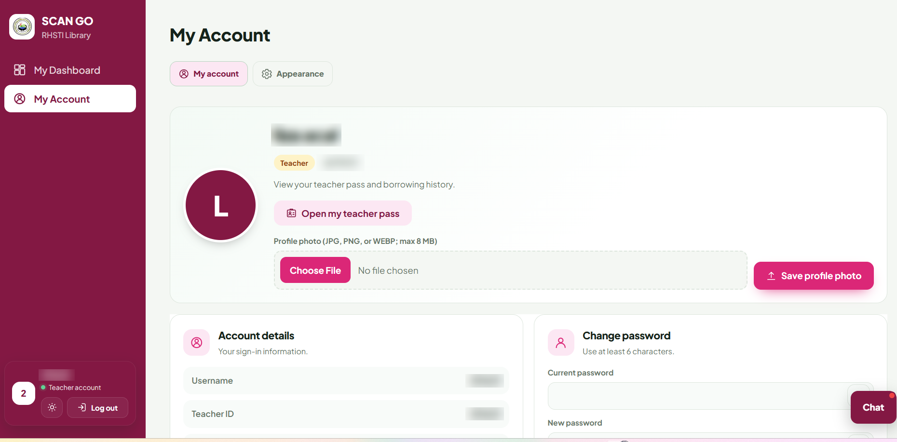
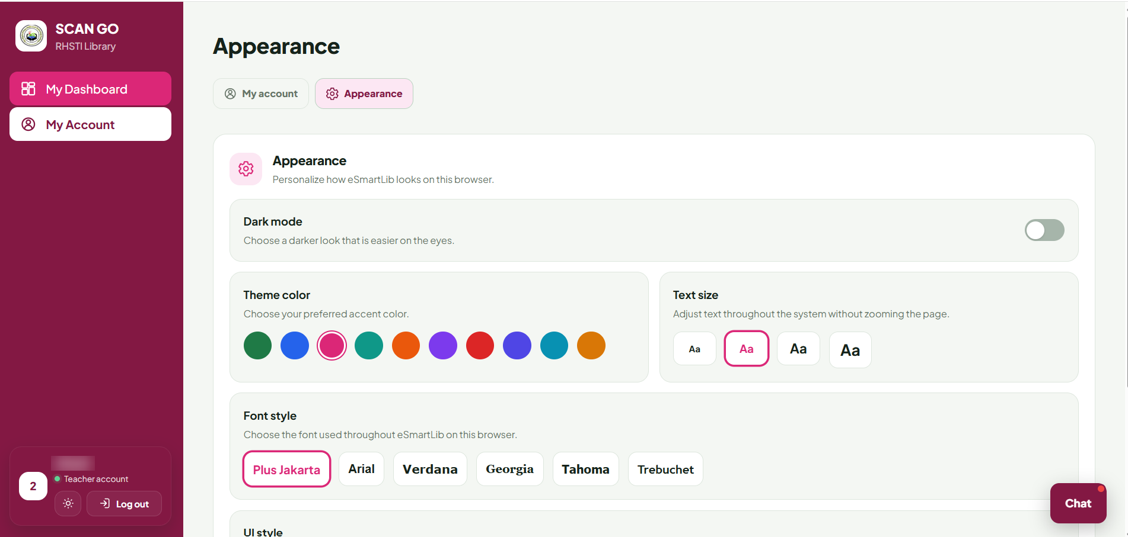
06 · LIVE DEMO · STEP 9 OF 9
Teacher Portal: Account and Appearance
Teacher account
Teacher appearance
Profile photo upload, account details, and change password. Name and ID are blurred.
Dark mode, theme color, text size, and font style, saved per browser.
E-SmartLib RHSTI · SE2 Final Defense · 17

Slide 18
07 · TESTING
Testing and Performance
Test type | What was tested | Result
Functional | Borrow, return, attendance, request | All functions are working
Integration | Scanner, API, database | Entegration is working
Performance | Response time | Efficient and fast
Security | Login lock, 10-minute reset code, 5 maximum wrong attempts | Log in lock and reset code are working as intended
Evidence from the live system (esmartlib.com, November 11, 2026): 3 borrow and return records, all returned on time; 20 history records. Enter only real results, including failed tests and the fixes made.
E-SmartLib RHSTI · SE2 Final Defense · 18
Notes:
Fabricated results are prohibited. Include bugs found and how they were fixed.

Slide 19
08 · STATUS
Capabilities and Limitations
Completed
Incomplete
Limitations
Student and book records, QR borrow and return, attendance, history, dashboard, student portal, Teacher portal, requests, chat, password recovery,
Offline use is not supported because the QR library needs the internet
Internet needed for QR libraries (CDN); camera scanning requires HTTPS or localhost
Future work: deployment at RHSTI, feedback from real users, and further analytics.
E-SmartLib RHSTI · SE2 Final Defense · 19
Notes:
Be honest about what is not finished. Disclosing it properly is what the guidelines require.

Slide 20
Thank You
Asis, Karen Claire | Project manager / team leader and Database administrator
Rada, Ahron Melvin | Lead programmer (PHP) and Front-end developer
Sulit, John Lloyd | System architect and Security and access developer
Laguador, Jake | Systems analyst
Era, Ken James | QR module developer
Sarte, Tim Jaztin | Attendance developer
Bascos, Francis | Database administrator
Agripa, John Carlo | Security and access developer
Lozano, King Jasper | Tester / quality assurance
Lacheca, Charles Kenneth | Security and access developer
Entong, Eduard John | Documentation and training officer
Turla, Alexander | Report and dashboard developer
Jalimao, John Vincent | Borrowing and returning developer
Question and Answer
Every member must be able to explain the system and their own contribution:
Notes:
Prepare for questions on the original system, enhancement, architecture, database, security, and individual contributions.

